Slide 1

PROJECT ON ANALYTICS
PRESENTED BY :
MAYURI DASHRATH KHATPE

Slide 2
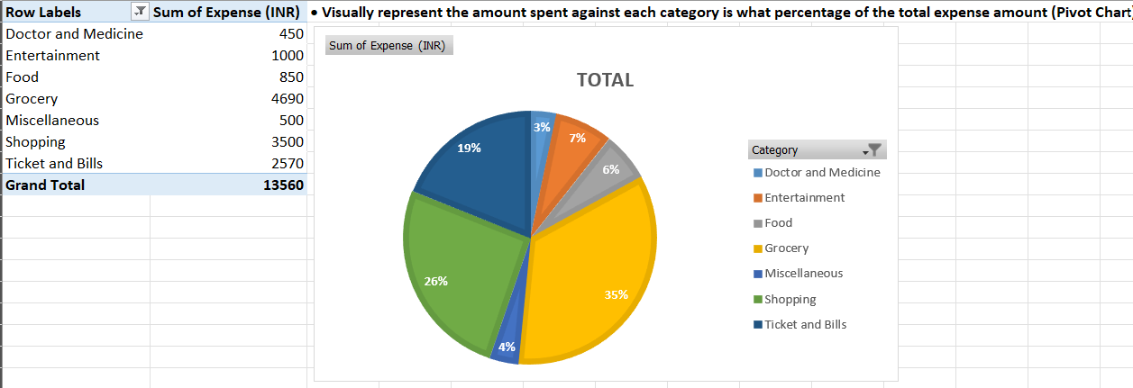
Part 1 - Task Responsibilities (Expense details for June data)
Task-1 : Visually represent the amount spent against each category is what percentage of the total expense amount (Pivot Chart)

Slide 3
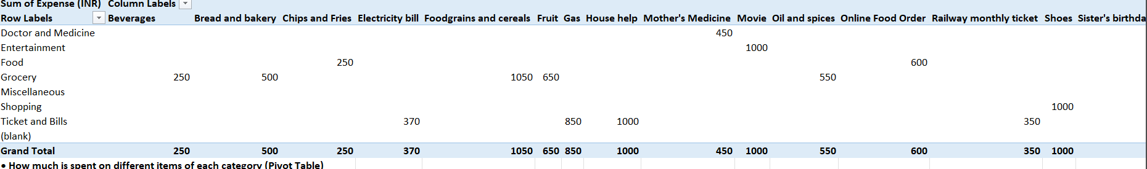
Task- 2(A) : How much is spent on different items of each category (Pivot Table)

Slide 4
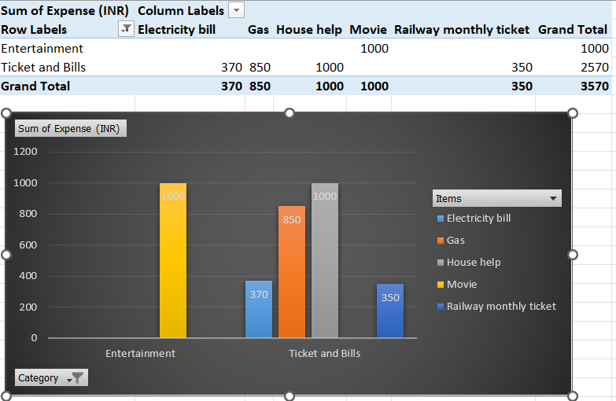
Task 2(B) : Visually represent the amount spent on different items of Entertainment and Tickets and bills category (Pivot Chart)

Slide 5
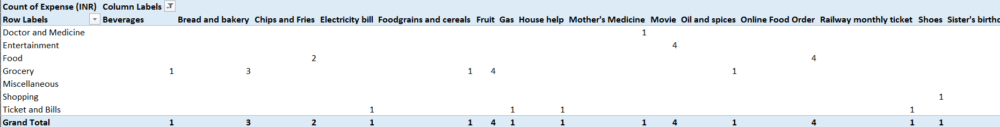
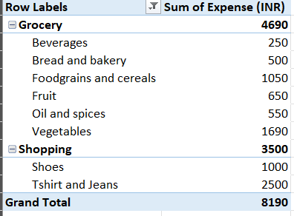
Task-3 (A) : How many times money has been spent against different items of each category (Pivot Table)
Task-3 (B) : Filter the data to display the data for Grocery items and Shopping items

Slide 6
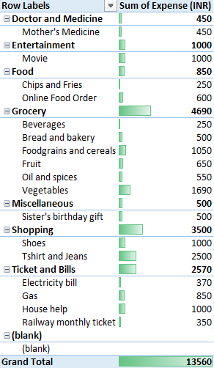
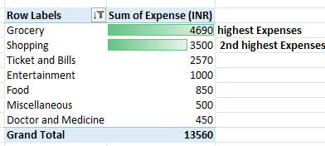
Task-4(A): Visually represent the data with data bars (Conditional formatting)
Task-4(B): What amount is spent on each item of the categories with highest and 2nd highest expense amount (Pivot Table)

Slide 7
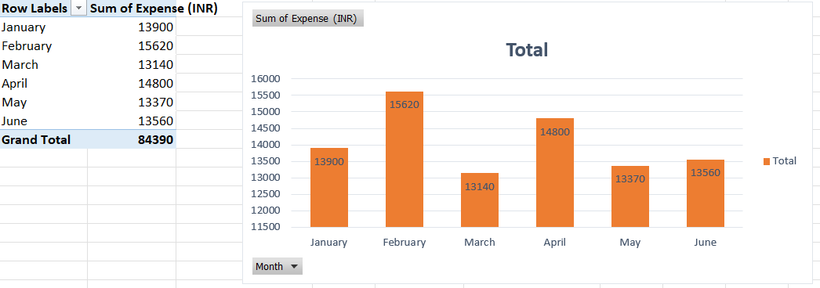
Part 2 - Task Responsibilities (Expense details for 6 months data)
Task-1(A):Month-wise trend of expenses (Pivot table and chart)

Slide 8
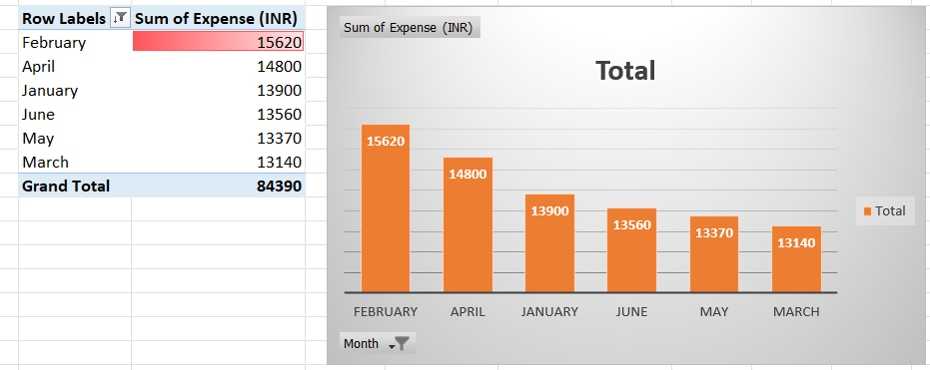
Task 1(B): Find out the month Nitin spent the most

Slide 9
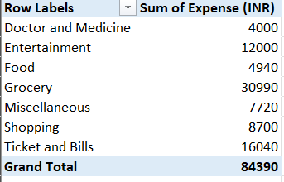
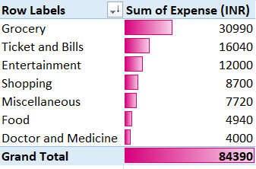
Task-2(A): Category wise expenses (Pivot table)
Task-2(B): Visually represent it with data bars to display categories with the highest and lowest expense amount

Slide 10
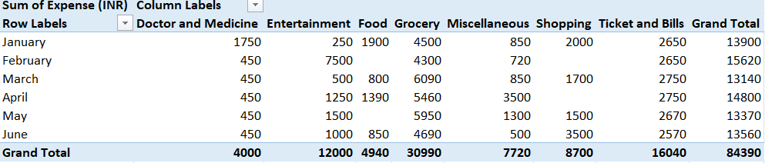
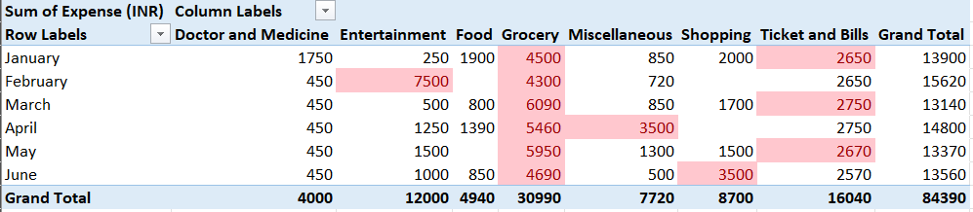
Task-3(A): Month-wise expense of each category (Pivot table)
Task-3(B): Find out 2 categories with higher expenses for each of the 6 months

Slide 11
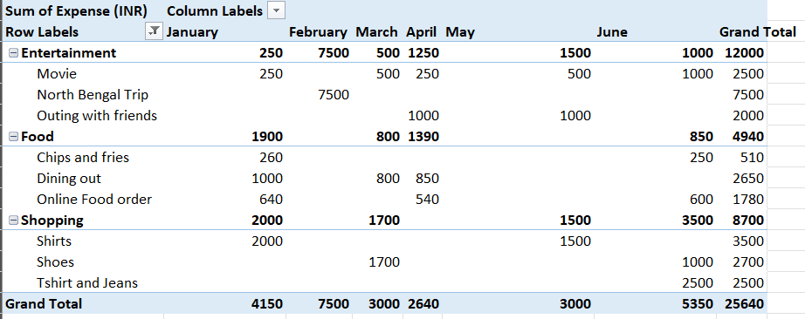
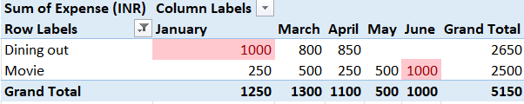
Task-4(A): How much is spent in each month against different items of Entertainment, Food and Shopping categories (Pivot table)
Task-4(B): Find out which months have the highest amount spent for movies and dining out

Slide 12
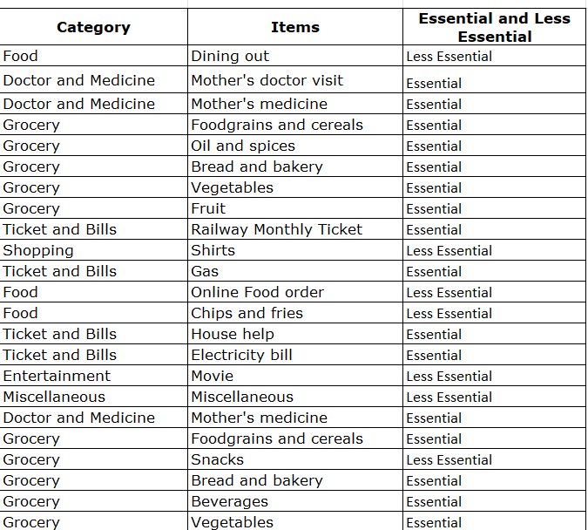
Task-5: Decide on the essential and less essential items and analyse the expenses
• Recommend how can Nitin increase his savings
 | Shop Smart: Buy only essential clothing and accessories during sales or with discounts.
 | Budget Activities: Choose affordable activities and avoid costly trips.
 | Dine Wisely: Reserve dining out for special occasions and enjoy home-cooked meals. Set a monthly dining-out budget.
 | Home Cooking: Decrease online food orders by planning and preparing meals at home.

Slide 13
THANK YOU……… ………………

